Slide 1
RoadMap of Youtube Recommendation System
Ke Wang

Slide 2

No Outline，Just Time Order

Slide 3
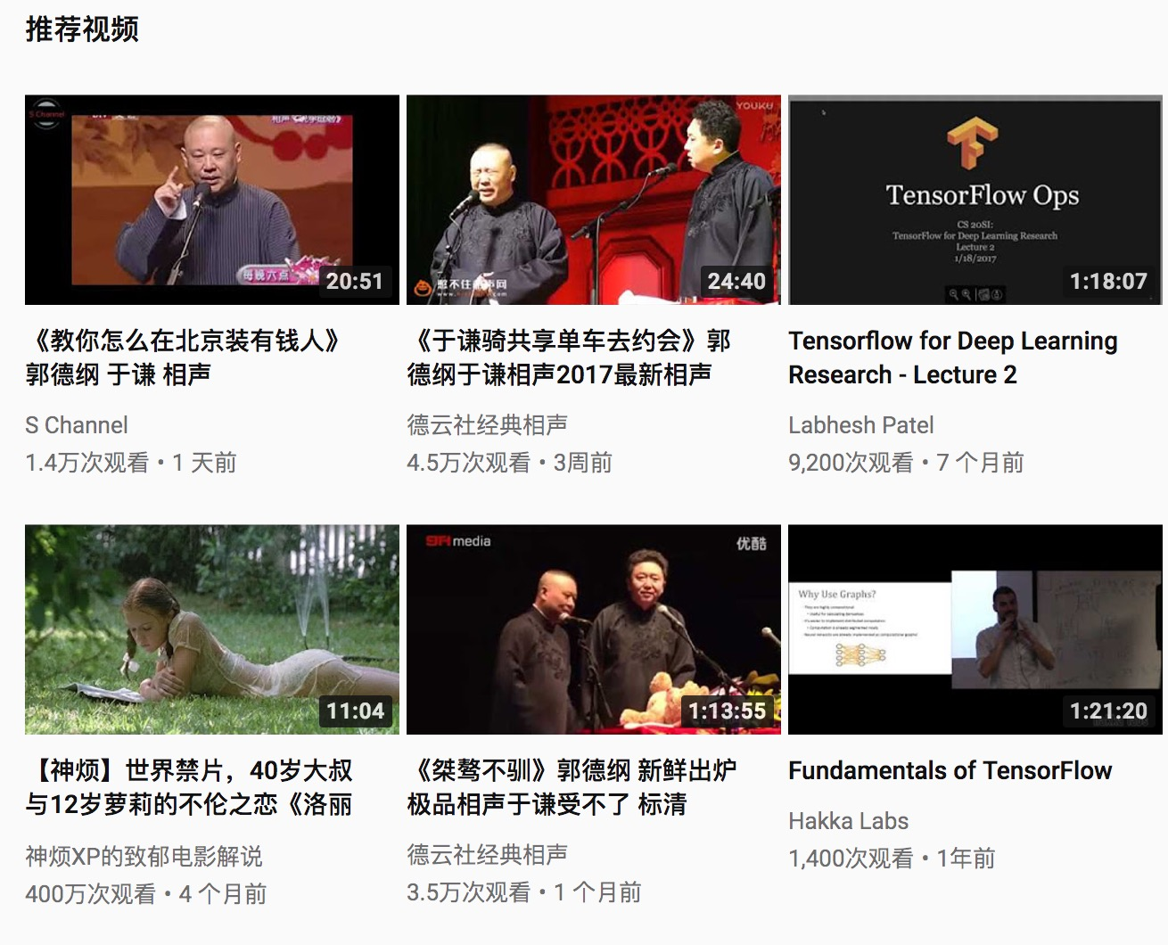
Recommendations of YouTube Web Site

Slide 4
Taking Random Walks Through the View Graph
Time：2008
Main Problem : …the tags that exist on YouTube videos are generally quite small; they only capture a small sample of the content…
Main Solution：
Video Co-View Graph
Adsorption Algorithm

Slide 5
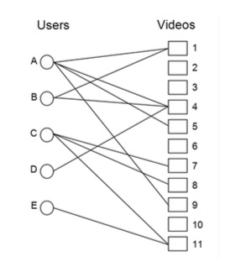
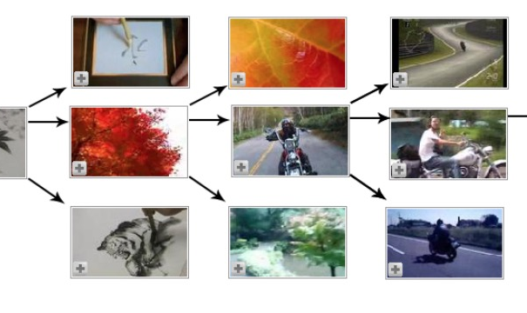
User-Video Graph
Video-Video Co-View Graph
User-Video Graph

Slide 6
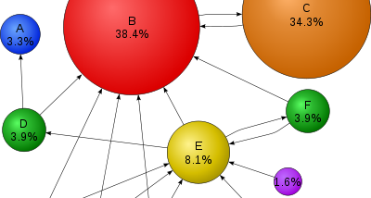
PageRank Algorithm

Slide 7
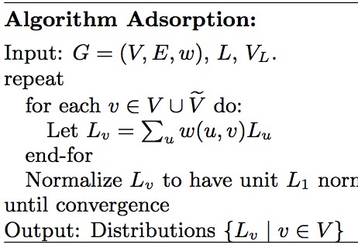
Adsorption Algorithm
Weight on the Edge between u and v
Label Probability Distribution

Slide 8
Co-Visitation Video Graph Traversing
Time : 2010
Main Problem : …videos as they are uploaded by users often have no or very poor metadata…
Main Method : The set of recommended videos is generated by using a user’s personal activity as seeds and expanding the set of videos by traversing a co-visitation based graph of videos.

Slide 9
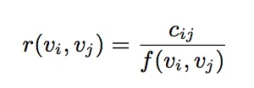
Related Videos
Co-watched times within sessions
Normalization function that takes the “global popularity”

Slide 10
Generating Recommendation Candidates
…
Seed
R₁
R₂
R₃

Slide 11
About Ranking
Linear combination of these signals :
Video Quality
User Specificity
Diversification.
Diversity:
Constraint the number of recommendations that are associated with a single seed video
Limit the number of recommendations from the same channel

Slide 12
System Implementation
Batch-oriented Pre-computation Approach:
MR Based Data Calculation
Results
Online Service
BigTable
Data Collection
Data Collection
Data Collection

Slide 13
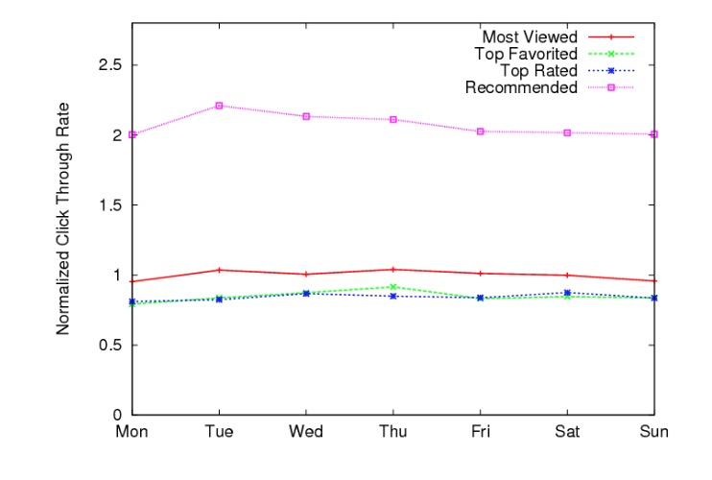
Evaluation
Per-day average CTR for different browse page types over a period of 3 weeks:

Slide 14
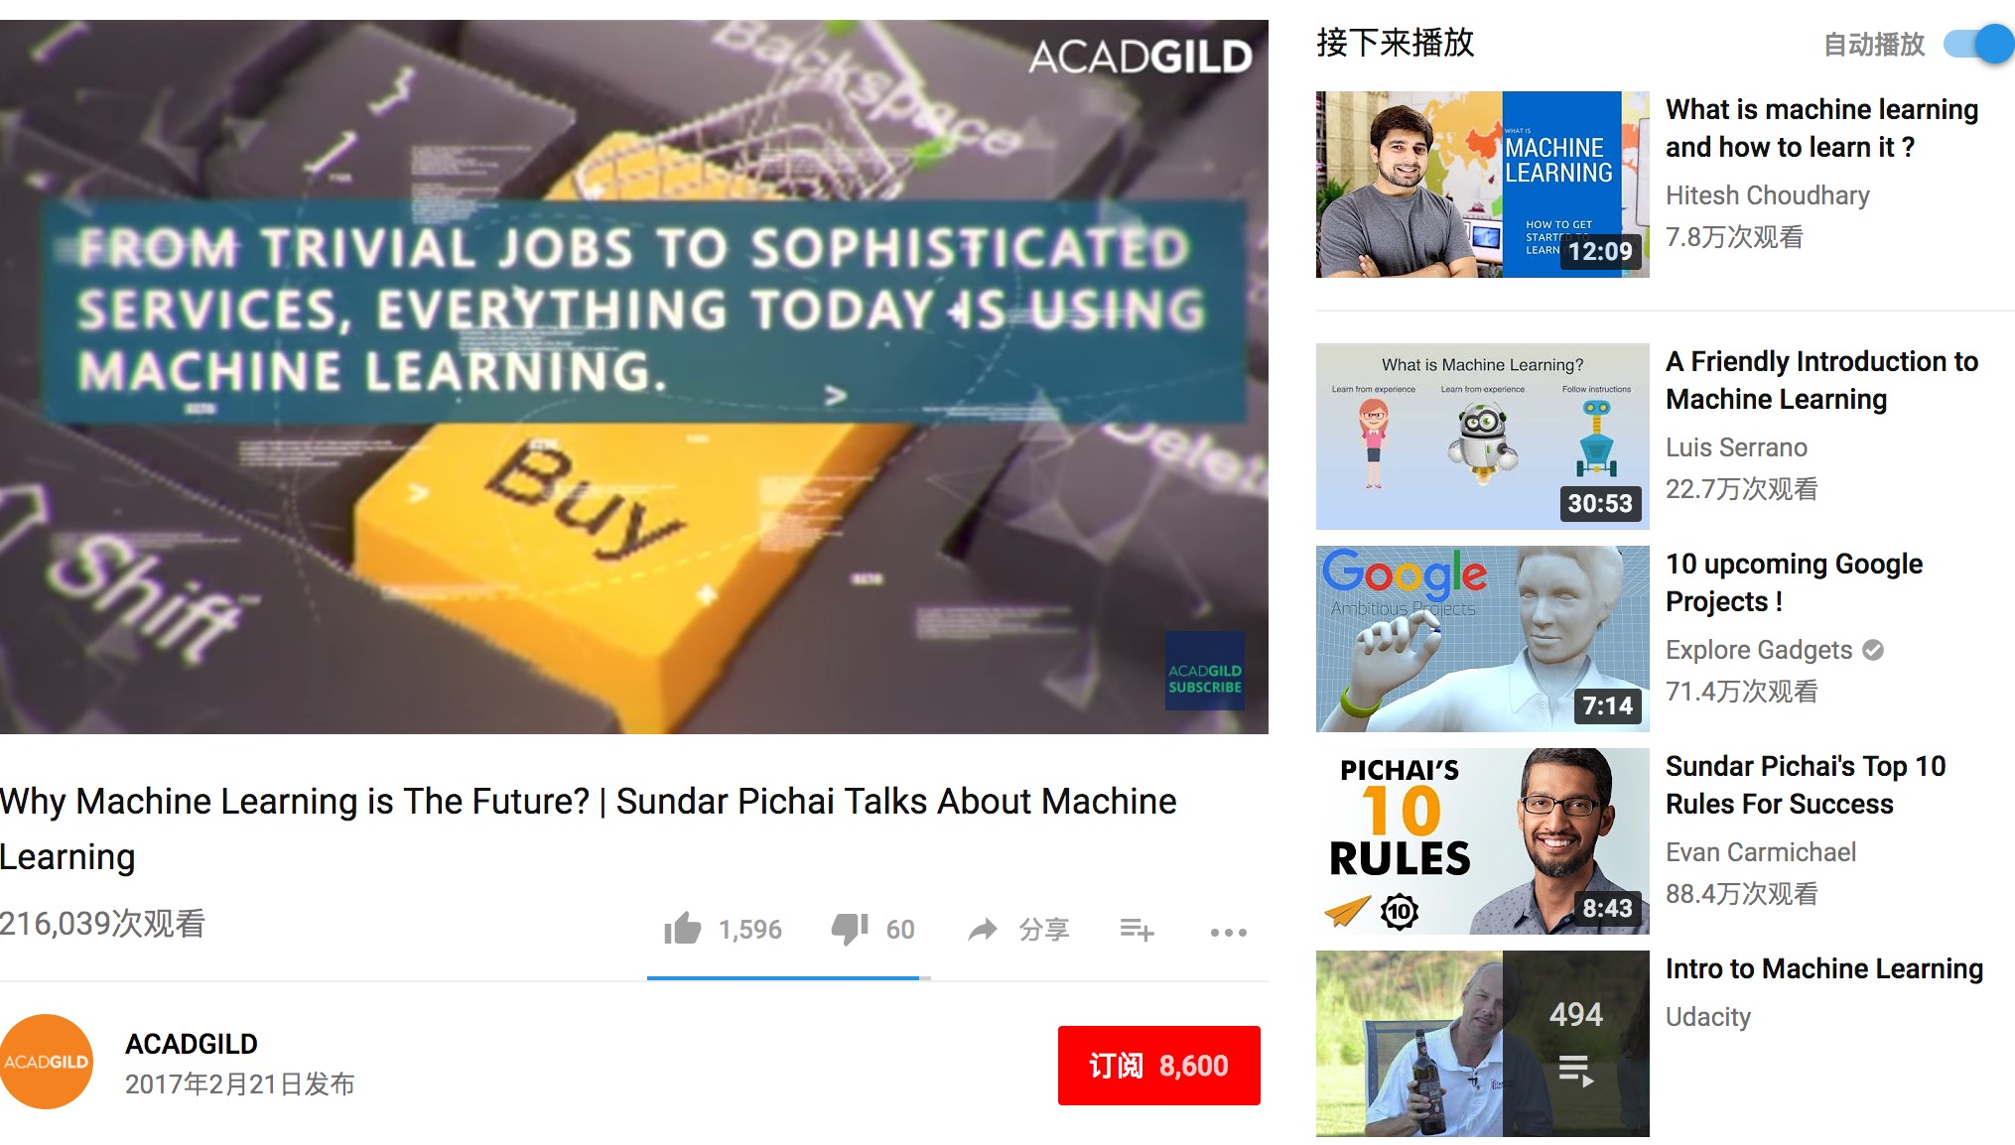
Video Suggestions on YouTube

Slide 15
Retrieval Methods for Related Video Suggestion
Time : 2014
Main Problem : Collaborative Filtering is less applicable to fresh videos or tail videos with few views, since they have very sparse and noisy co-view data.
Main Solution : Augmenting the collaborative filtering analysis with the topical representation of the video content to suggest related videos.

Slide 16
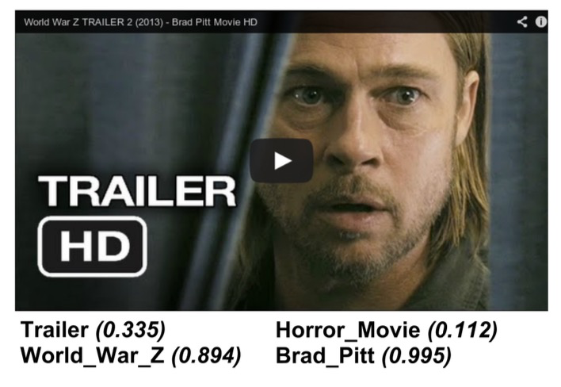
Video Representation
Topics associated with a video, and their corresponding weights.

Slide 17
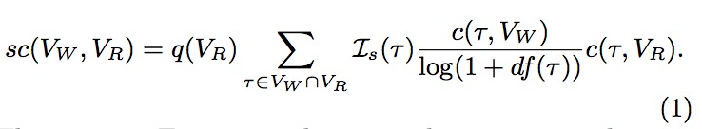
Retrieval With Weighted Topics
The topic count function c(t, V ) returns a normalized count of videos that are annotated with the topic t and are co-viewed with the video V.
log(1 + df(t)) is an inverse document frequency component that penalizes frequently occuring topics.
The indicator function Is (t) removes very frequent stopwords at either indexing time or query time.
q(V_{R}) is overall quality of the related video.

Slide 18
Problem : Relative Importance of Topic
A topic can have relatively low co-occurence counts for both the watch and the related videos, yet still be beneficial for the retrieval of relevant re-lated videos.

Slide 19
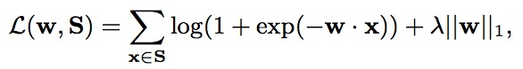
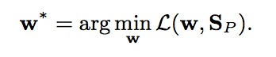
Learning Topic Transitions
Most generally, we seek topic transition weight assignments such that the clicked and viewed related video will be preferred by the model to the suggested video ignored by the user.
Pairwise Ranking: The pair of unclicked and clicked data make one training point.
x is 1 if the topic is associated only with the positive example,-1 if the topic is associated only with the negative example.
We seek a weight vector w, which minimizes the l1- regularized logistic loss over the train set ：

Slide 20
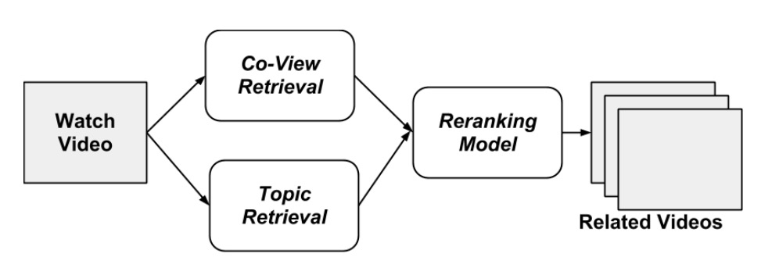
System Implementation
The inverted index structure enables efficient scoring of the related candidate videos in response to a watch video.
We integrate both the co-view based and the topic-based retrieval methods into a single video suggestion system:

Slide 21
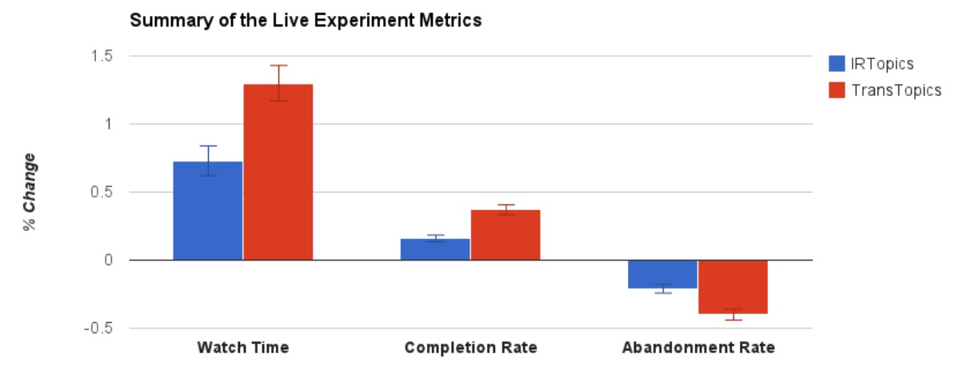
Summary of The Live Traffic Experiment

Slide 22

Deep Neural Networks for YouTube Recommendations
Time：2016

Slide 23
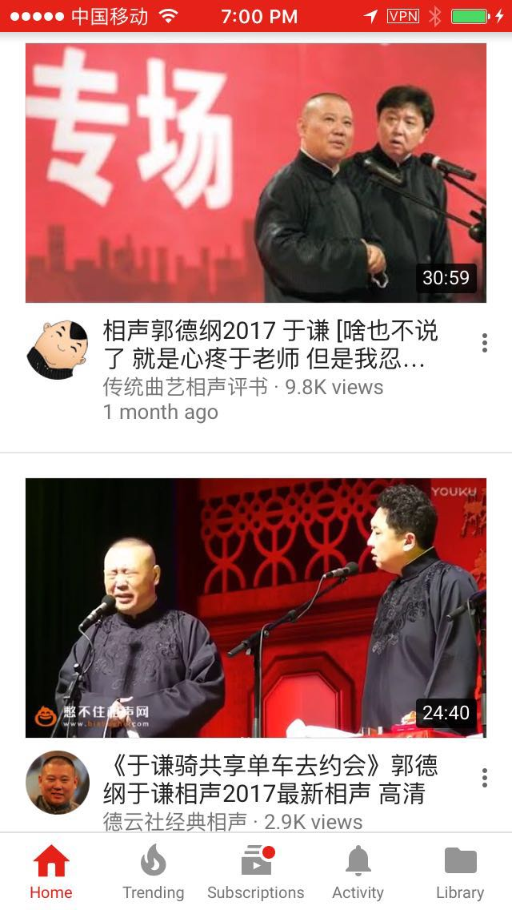
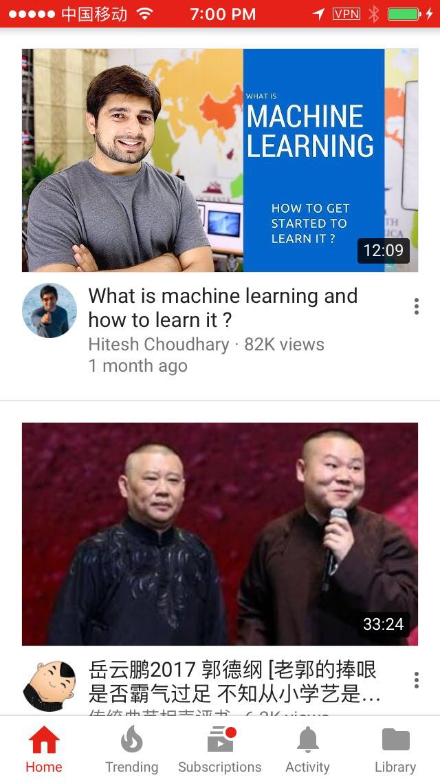
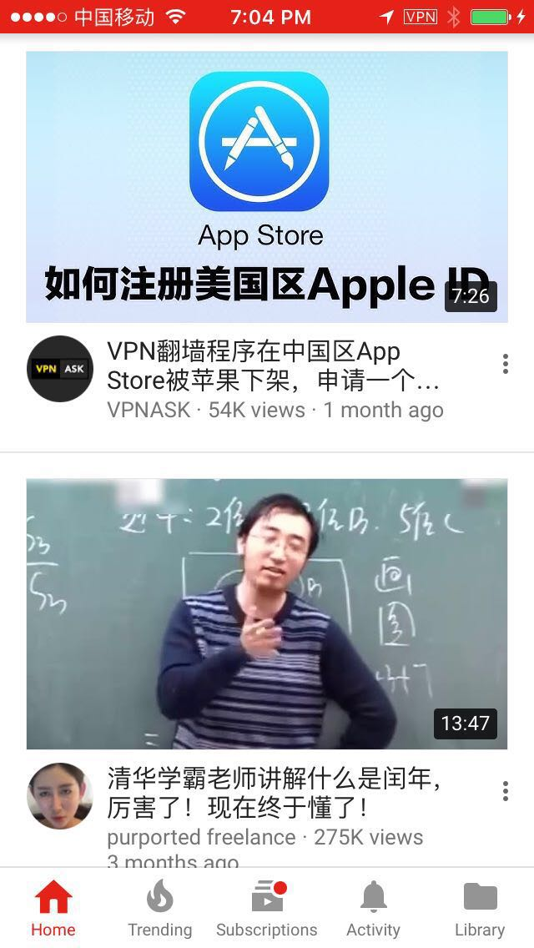
Recommendations of YouTube Application

Slide 24
Why Deep Neural Networks?
Main Reason : ..using deep learning as a general-purpose solution for nearly all learning problems..
Main Problem:
Scale : Highly specialized distributed learning algorithms and efficient serving systems are essential..
Freshness : should model newly uploaded content as well as the latest actions taken by the user.
Noise : We rarely obtain the ground truth of user satisfaction and instead model noisy implicit feedback signals. Metadata associated with content is poorly.

Slide 25
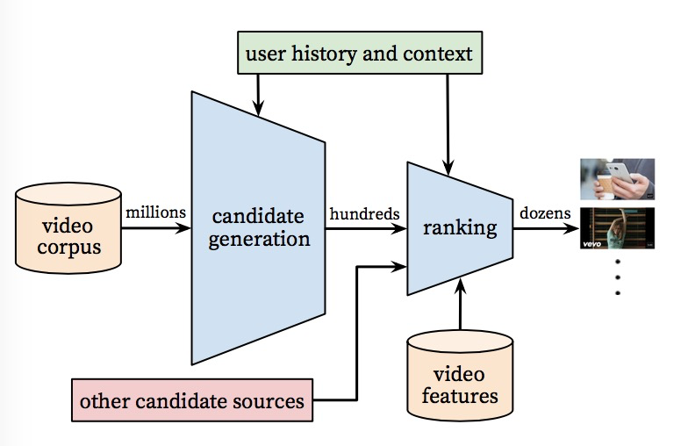
System Architecture Overview
The system is comprised of two neural networks: one for candidate generation and one for ranking.

Slide 26
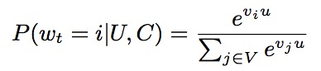
Recommendation as Classification
We pose recommendation as extreme multiclass classification problem:
video watch w_{t} at time t
User
Context
Corpus

Slide 27
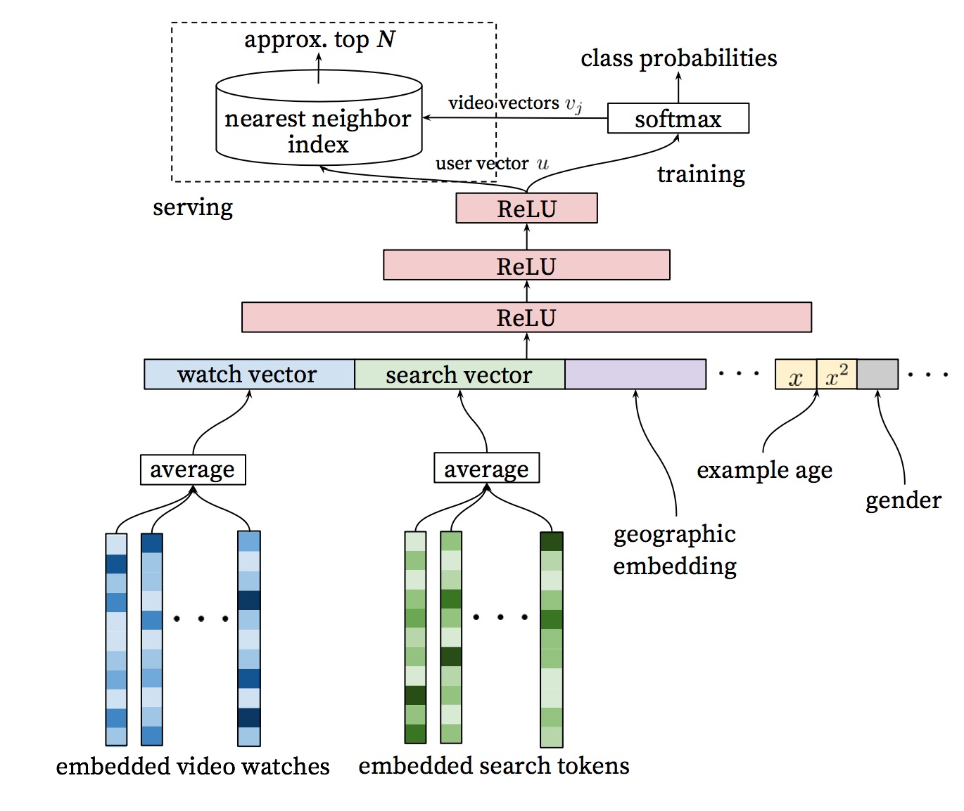
Deep Candidate Generation Model Architecture
Learn Embeddings for each video in a fixed vocabulary.
Arbitrary continuous and categorical features can be easily added to the model.

Slide 28
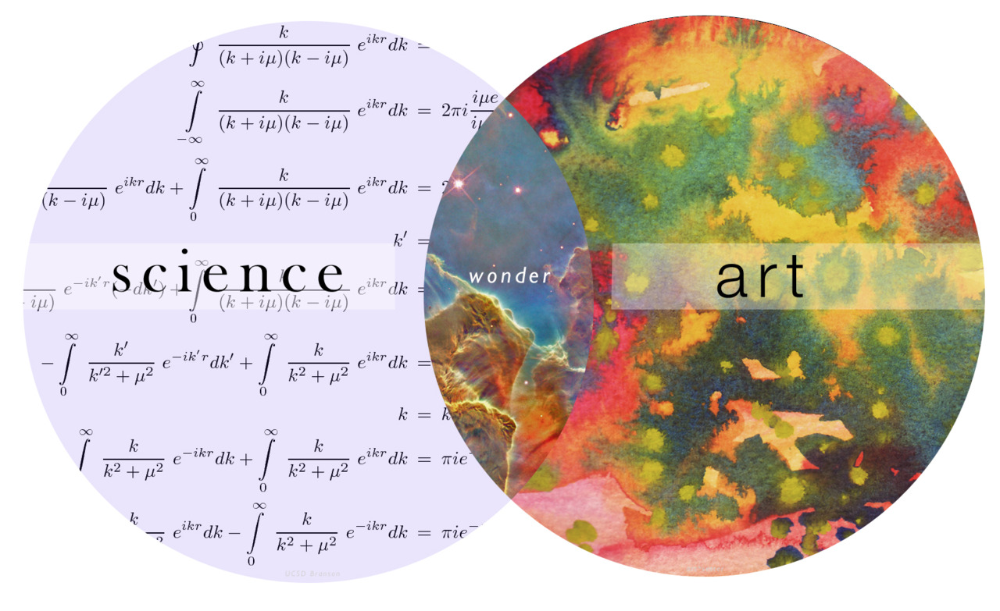
Choices About Surrogate Problem

Slide 29
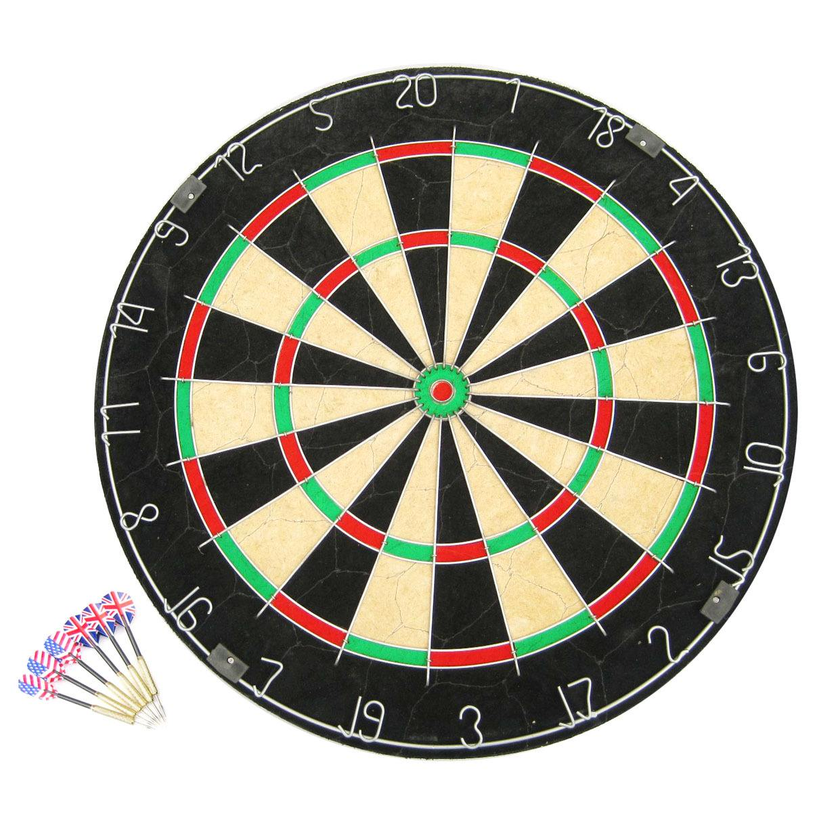

What’s the Product Optimization Target?
VS
Click Through Rate
Play Time

Slide 30


What’s the Input of the Recommendation System?
Explicit Feedback:
Thumbs Up/Collect
Implicit Feedback:
Click/Watch Time

Slide 31


How to Recommend Recently Uploaded Content?
Recently Uploaded Contents
Users:
Prefer fresh content, though at the expense of relevance.
Uploader:
Look forward to see the feedback from users.
Application:
Recommending them is extremely important as a product.

Slide 32
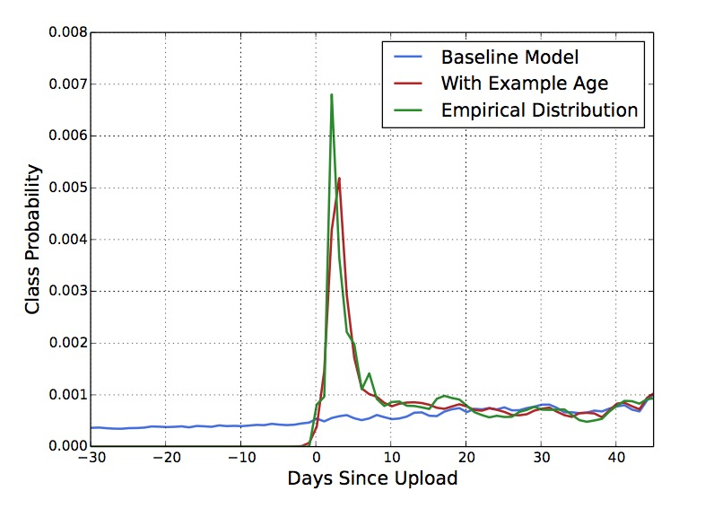
Solution: “Example Age” Feature
Just feed the age of the training example as a feature.

Slide 33
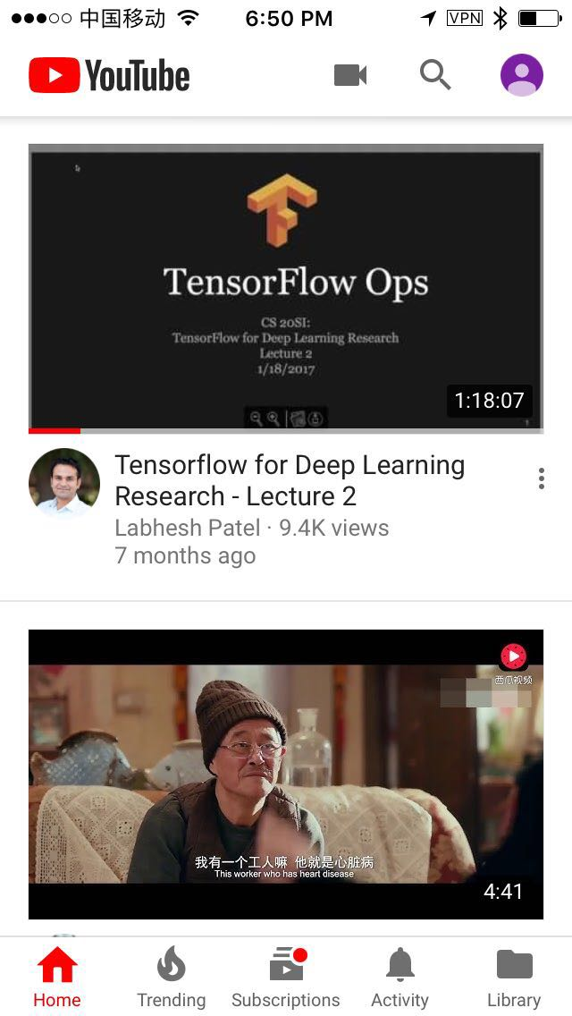
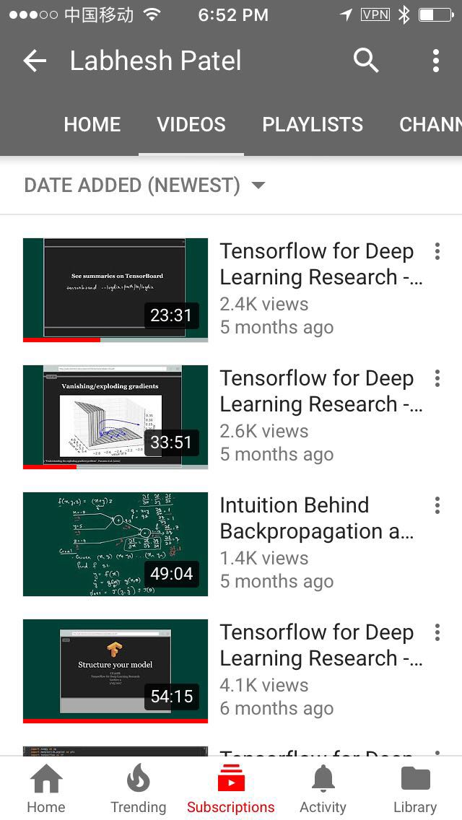
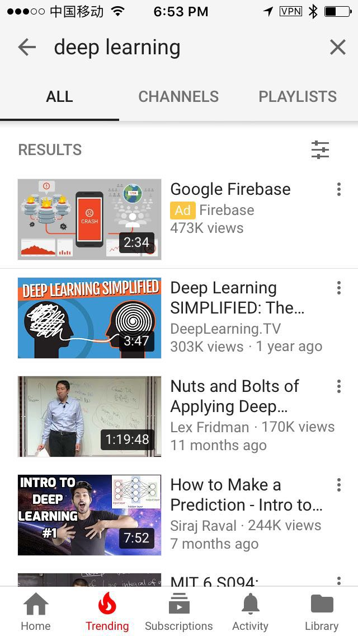
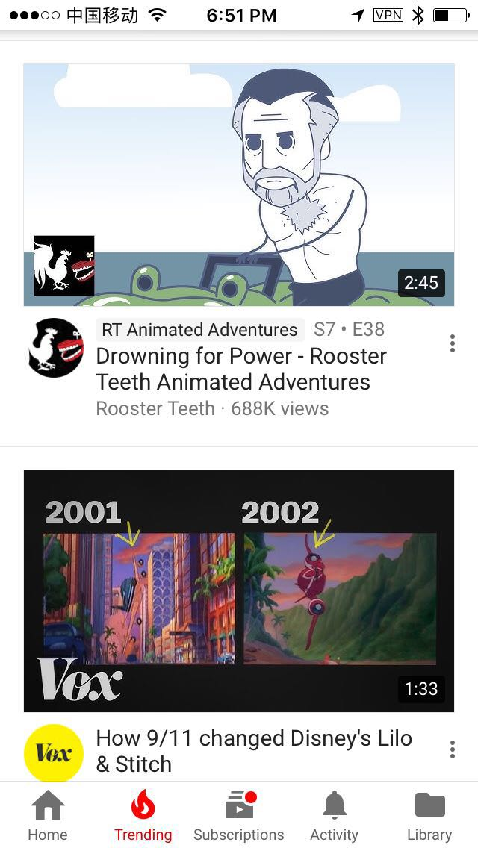
Training Examples Generation Source
VS
Just Recommendations
All YouTube Watches

Slide 34

Training Examples Sampling Method
VS
Time
A fixed number of training examples per user
A fixed number of training examples for one period of time recently

Slide 35
Retain or Discard Sequence Information?
VS
Feed sequence information into Classifier
Withhold sequence information

Slide 36
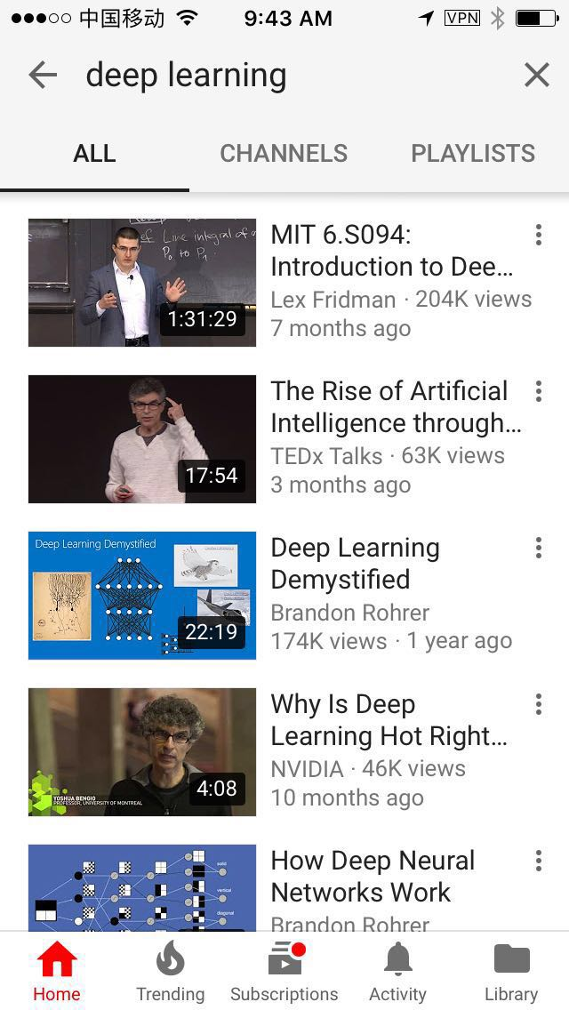
Predict Future or Randomly Held-out Video?
VS
Predict Held-out Watch
Predict Future Watch

Slide 37
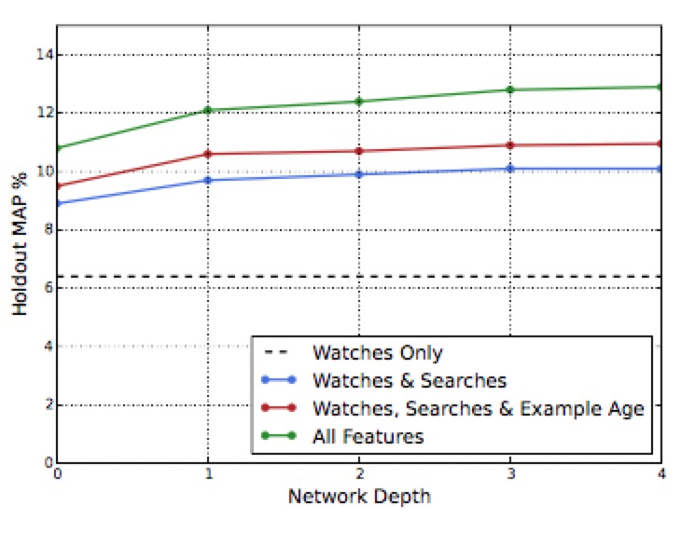
Experiments with Features and Depth
Depth 0: A linear layer simply transforms the concatenation layer to match the softmax dimension of 256
Depth 1: 256 ReLU
Depth 2: 512 -> 256 ReLU
Depth 3: 1024 -> 512 -> 256 ReLU
Depth 4: 2048 -> 1024 -> 512 -> 256 ReLU

Slide 38

Target and Main Method of Ranking
Candidate Generation:
For Each User
Huge Corpus and Less Features
Ranking:
For User’s Interface(Context)
Small Corpus and Much More Features
Ensembling Different Candidate Sources

Slide 39
What’s the Predicted Object of the Ranking Model?
+
Click Through Rate
Play Time

Slide 40
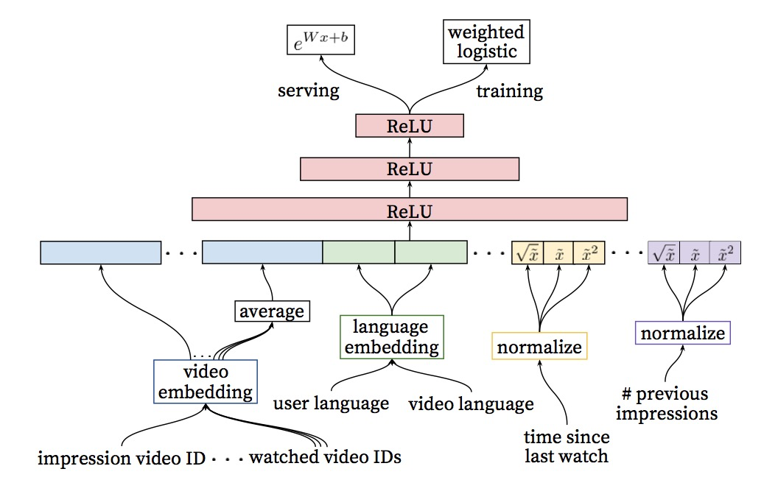
Deep Ranking Network Architecture
Weighted Logistic Regression:
Positive examples are annotated with watching time.
Most important signals are user’s previous interaction with the item itself and other similar items.
Features describing the frequency of past video impressions are also critical for introducing “churn” in recommendations

Slide 41
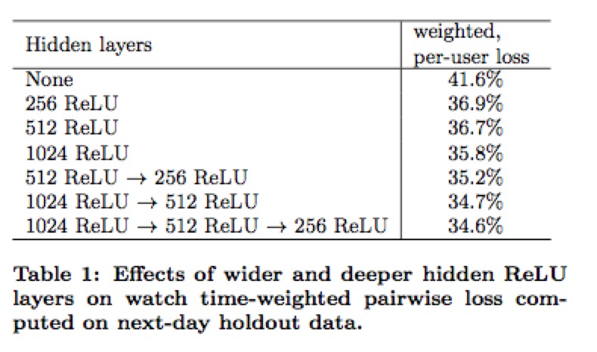
Experiments with Hidden Layers
If the negative impression receives a higher score than the positive, then we consider the positive impression’s watch time to be mispredicted watch time.
Weighted, per-user loss is then the total amount mispredicted watch time as a fraction of total watch time over heldout impression pairs.

Slide 42
RoadMap of YouTube Recommendation System
 | Previous | Current
Environment | Web Site | Mobile Application
Method | User Profile/Collaborative Filtering | Deep Neural Networks
Model | Heuristic | Multiclass Classification
Test | Offline | Online Live Traffic
Metric | CTR | PlayTime
Notes:
https://www.theverge.com/2017/8/30/16222850/youtube-google-brain-algorithm-video-recommendation-personalized-feed

Slide 43
Google Brain Gave YouTube New Life
70%
People spend watching is now driven by YouTube’s recommendations.
Search/Channels no longer dominate YouTube as they once did.

Slide 44
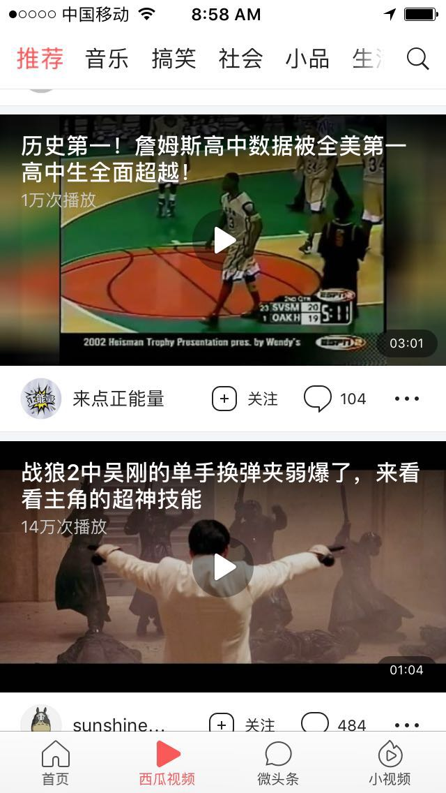
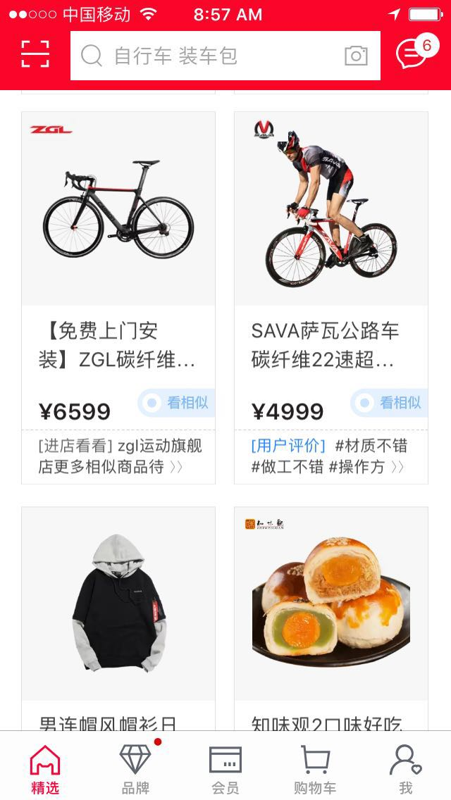
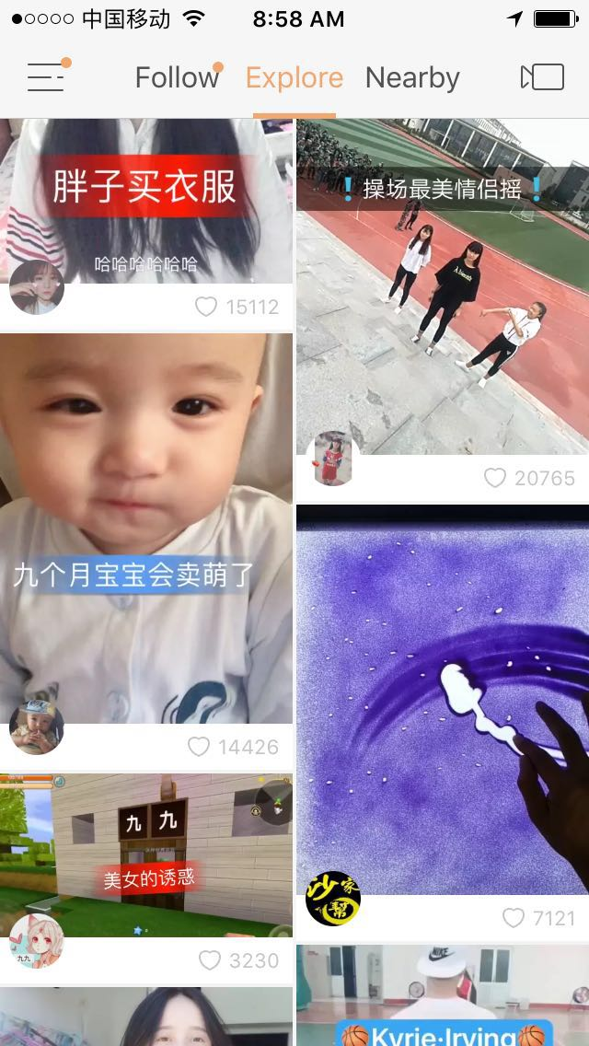
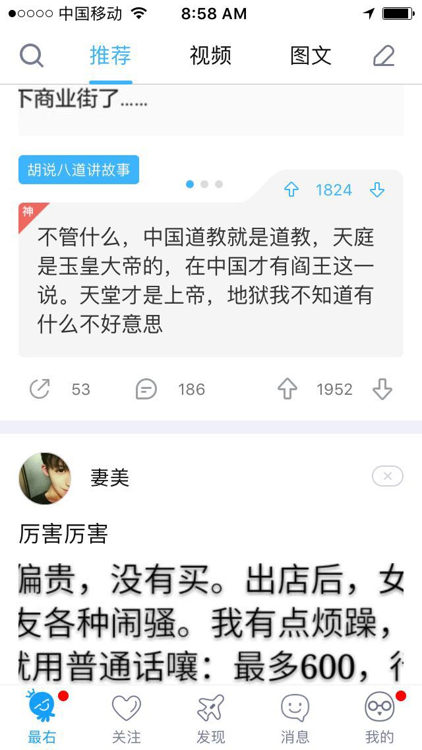
Recommendation Will Dominate Future APPs
Algorithm/Recommendation/Feed will be one extremely important part of future applications, more important than search, navigation and subscription.
Notes:
https://www.theverge.com/2017/8/30/16222850/youtube-google-brain-algorithm-video-recommendation-personalized-feed

Slide 45
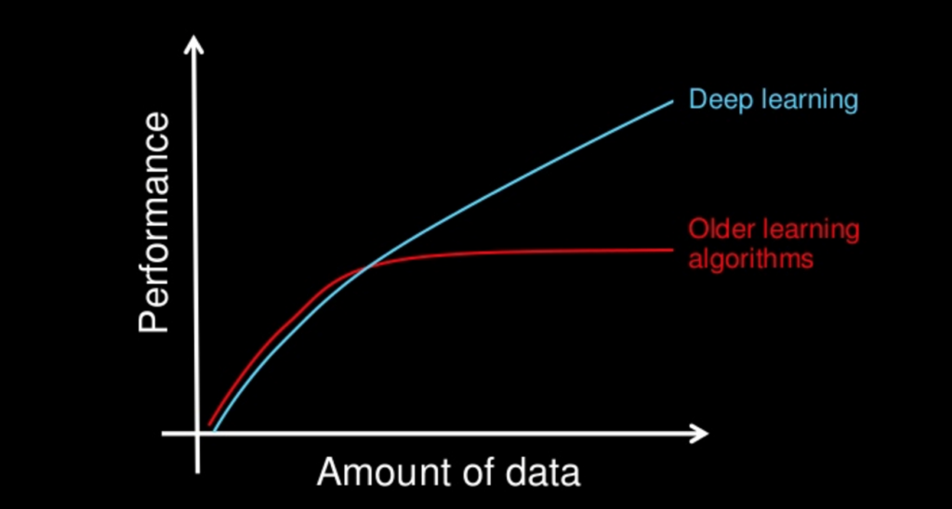
Deep Learning Will be the Future of Recommendation

Slide 46
Small Gift : Earth
https://github.com/wangkobe88/Earth
Based on TensorFlow;
It uses dbpedia data,treats the documents as users, and the document's classification as the video;
This means we know the features(information) of the users, so we use them to infer the video which the users will play.

Slide 47
Thank You!

Slide 48
Google Brain Gave YouTube New life
The first big change was in 2012:
Instead of how many people had clicked a video, YouTube would instead base them on how long people had spent watching it.
Watch time on YouTube grew 50 percent a year for the next three years.
YouTube started using Google Brain in 2015, a replacement for the older AI system called Sibyl.
YouTube launched 190 changes like this one in 2016, and is on pace to release 300 more this year.
the aggregate time people spend watching videos on YouTube’s home page has grown 20 times larger than what it was three years ago.
Notes:
https://plus.google.com/+PeggyKTC/posts/Ep7Kt13a9QJ

